Slide 1


SCMS SCHOOL OF ENGINEERING AND TECHNOLOGY
DEPARTMENT OF COMPUTER SCIENCE AND ENGINEERING
NOVAUX : AI-ASSISTANT FOR STARTUPS
Project Guide :
Ms.Hafeesa M.Habeeb Assistant Professor
Department of CSE
SSET
Presented by:
Marvin Michael SCM22CS141
Navaneeth Krishna K K SCM22CS153
Nayana Binu Plachikattil SCM22CS156
Neha S Ramadi SCM22CS158
1

Slide 2

CONTENTS
Introduction
Objective of the project
Motivation of the project
Challenges and considerations
Literature survey
System architecture
Methodology
Module description
Implementation and details
Roadmap of the project
References

Slide 3
INTRODUCTION
India’s startup ecosystem is among the fastest-growing in the world, with over 26,000 ventures launched. Yet, nearly 90% of these startups fail within five years, with regulatory non-compliance being a major, often underestimated cause (IBM Institute & Oxford Economics, 2017).
Many founders face unclear legal frameworks, evolving regulations, and limited access to affordable legal expertise — exposing their ventures to legal penalties, stalled operations, and investor hesitation.
Strong legal support is essential for early-stage startups. It helps avoid costly mistakes, resolve disputes, secure investor trust, and protect intellectual property.
More than just protection, it lays the foundation for sustainable growth and long-term success. There is a growing need for accessible, intelligent, and proactive legal support tailored to the realities of India’s startup landscape.

Slide 4
OBJECTIVE OF THE PROJECT
To develop an AI-driven assistant that seamlessly integrates large language models, semantic document retrieval, and predictive analytics to simplify legal compliance, regulatory interpretation, and strategic decision-making for startups.
The platform further enhances operational efficiency by providing personalized scheme matching and generating essential legal documents through a unified, text-based interface.

Slide 5
MOTIVATION OF THE PROJECT
Startups are economic growth engines – contributing ~4–5% of India’s GDP and playing a key role in the $5 trillion economy vision
Regulatory complexity is a major barrier – with 1,536 business-related laws and oversight from 42 ministries/departments.
Legal & compliance issues cause avoidable failures – 19% of startup failures are due to legal challenges, making it one of the top preventable causes where an AI-powered legal assistant can directly help.

Slide 6
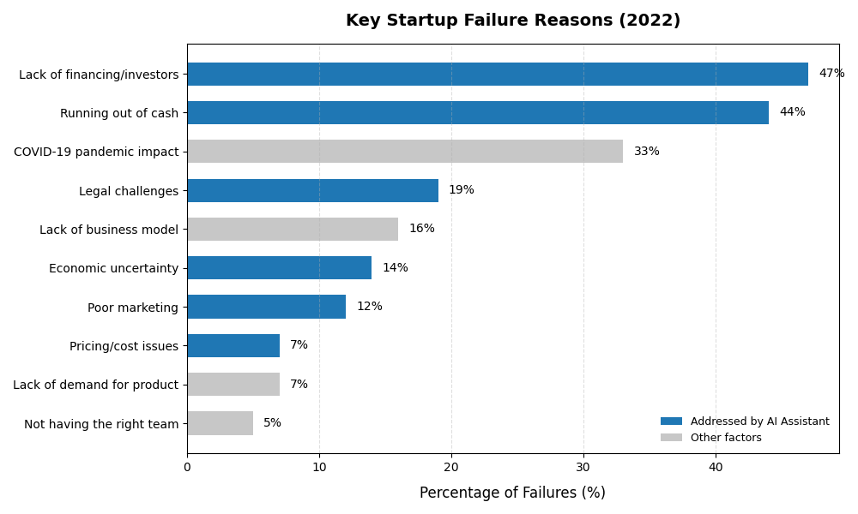
MOTIVATION OF THE PROJECT

Slide 7
CHALLENGES AND CONSIDERATIONS
Extracting reliable, structured data from legal PDFs.
Keeping up with updated laws and scheme policies.
Ensuring answer accuracy to avoid misinformation.
Maintaining explainability and user trust in legal recommendations.
Efficiently running LLMs with limited hardware.

Slide 8
LITERATURE SURVEY
Sl.NO | TITLE | AUTHORS | METHODOLOGY | INFERENCE
1 | Legal Query RAG[1] | Rahman S. M. Wahidur et al. | Introduced a domain-adapted RAG framework with recursive feedback, prompt agents, and fine-tuned LLMs. | Reduces hallucination, improves legal answer accuracy. Lacks human evaluator involvement.
2 | Exploring LLM Answering in Entrepreneurship Education[2] | Qi Lang et al | Evaluates LLMs in handling interdisciplinary entrepreneurship questions using math/semantic reasoning benchmarks. | LLMs enhance learning support but struggle with precision in financial/risk questions. Needs model fusion and optimization.

Slide 9
LITERATURE SURVEY
Sl.NO | TITLE | AUTHORS | METHODOLOGY | INFERENCE
3 | Predicting the success of startups using a machine learning approach[3] | Razaghzadeh Bidgoli et al. | Used machine learning to classify startup success based on features like funding, social media presence, team, plus clustering and SHAP for feature importance analysis. | Random Forest achieved ~82% accuracy; LinkedIn followers, employee counts, Twitter presence, and last raised funding were key predictors. The model depends heavily on publicly visible variables
4 | Exploring LLMs in Law: A Literature Review[4] | Marco Siino et al. | Surveys existing legal NLP and LLM approaches including QA, summarization, and legal reasoning. | Shows promising use of LLMs in legal NLP Highlights limitations in explainability and legal grounding.
Notes:
LITERATURE SURVEY

Slide 10
LITERATURE SURVEY
Sl.NO | TITLE | AUTHORS | METHODOLOGY | INFERENCE
5 | Enhancing Legal QA with Data Generation and Knowledge Distillation[5] | Paolo Italiani, Gianluca Moro, Luca Ragazzi | Trains a small legal QA model using synthetic data from a frozen LLM and introduces Selective Generative Paradigm. | Achieves LLM-comparable performance with 1200% less CO₂ and no human annotations. Not scalable beyond current datasets.
Notes:
LITERATURE SURVEY

Slide 11
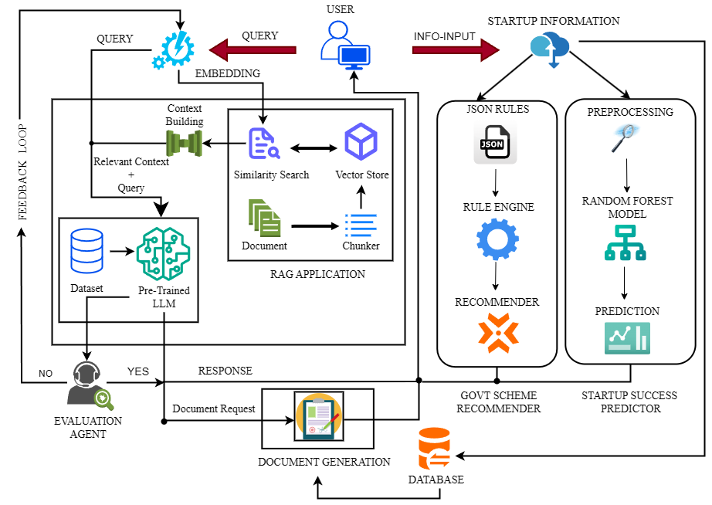
SYSTEM ARCHITECTURE

Slide 12
METHODOLOGY
Preprocessing and Embedding Legal Texts
Legal PDFs (e.g., Acts, contracts, scheme guidelines) are parsed and cleaned using OCR and PDF parsers.
Texts are chunked for better retrieval [1].
Each chunk is embedded using SentenceTransformers based on legal-tuned models [3].
Startup Success Predictor (ML Model)
Inputs: founder experience, location, sector, funding type.
Uses a trained Random Forest classifier on labeled startup data.
Returns risk score or success probability [4].

Slide 13
METHODOLOGY
Scheme Matching with Rule-Based Filtering
Startup details (type, domain, registration status) are matched with central/state schemes.
Uses JSON-based rules and eligibility filters.
Explains benefits, conditions, and links for each matched scheme.
Document Generator
Auto-generates templates like pitch decks, NDAs, MoUs, and RTI drafts using LLM prompts.
Output is editable and downloadable (PDF/DOCX).
Templates can be updated based on user input fields (e.g., company name, purpose).

Slide 14
MODULE DESCRIPTION
1. Legal Q&A Engine:
Accepts user questions.
Retrieves law sections using ChromaDB[1].
Uses LLM to answer in plain language[1][2].
2. Legal Document Summarizer:
Accepts PDFs (e.g., Acts, contracts).
Extracts and converts into simplified summaries[1][3].
3. Startup Success Predictor:
Takes inputs like domain, experience, funding, location.
Uses ML model to return risk score / probability[4].
Notes:
4. Scheme Advisor
Matches user profile with central/state startup schemes.
Returns eligibility, application steps, and official links.
5. Business Tips Engine
Suggests startup strategies: fundraising, hiring, customer discovery, etc.
6. Document Generator
Auto-generates pitch decks, NDAs, partnership agreements, RTI drafts.

Slide 15
MODULE DESCRIPTION
4. Scheme Advisor:
Matches user profile with central/state startup schemes[4].
Returns eligibility, application steps, and official links[5].
5. Business Tips Engine:
Suggests startup strategies: fundraising, hiring, customer discovery, etc [5].
6. Document Generator:
Auto-generates pitch decks, NDAs, partnership agreements, RTI drafts[1].

Slide 16
IMPLEMENTATION DETAILS
Language | Python
Embeddings | Sentence Transformers.
OCR | Tesseract OCR
Database | PlSQL
Vector DB | ChromaDB
Frontend | HTML,CSS,Javascript
ML | Random Forest

Slide 17
ROAD MAP OF THE PROJECT
No. | TASK NAME | JULY 01ST -15TH | JULY 16TH -31ST | AUG 1ST -15TH | AUG 16TH -31ST | SEPT 1ST -15TH | SEPT 16TH -30TH | OCT 1ST -15TH | OCT 16TH -31ST | NOV 1ST -15TH | NOV 16TH -30TH | DEC 1ST -15TH | DEC 16TH -31ST | JAN 1ST -15TH | JAN 16TH -31ST | FEB 1ST -15TH | FEB 16TH – 28TH
1 | Problem Identification and Title Selection
2 | Literature Survey and Research
3 | Problem Statement Refinement and Topic Finalization
4 | Designing
5 | Legal Data Collection & Preprocessing
6 | Embedding + Retrieval System+LLM Promt Generator And Q&A Integration
7 | Legal Document Summarizer & Start Up Success Predictor & Govt Scheme Matcher
8 | Integration and Testing
9 | Preparation for Journal / Conference Publication
10 | Documentation

Slide 18
REFERENCES
[1] R. S. M. Wahidur, S. Kim, H. Choi, D. S. Bhatti and H. -N. Lee, "Legal Query RAG," in IEEE Access, vol. 13, pp. 36978-36994, 2025, doi: 10.1109/ACCESS.2025.3542125.
[2] Italiani, P., Moro, G. & Ragazzi, L. Enhancing legal question answering with data generation and knowledge distillation from large language models. Artif Intell Law (2025). https://doi.org/10.1007/s10506-025-09463-9
[3] M. Siino, M. Falco, D. Croce and P. Rosso, "Exploring LLMs Applications in Law: A Literature Review on Current Legal NLP Approaches," in IEEE Access, vol. 13, pp. 18253-18276, 2025, doi: 10.1109/ACCESS.2025.3533217.
[4] Razaghzadeh Bidgoli, M., Raeesi Vanani, I. & Goodarzi, M. Predicting the success of startups using a machine learning approach. J Innov Entrep 13, 80 (2024). https://doi.org/10.1186/s13731-024-00436-x

Slide 19
REFERENCES
[5] Q. Lang, S. J. Tian, M. Wang, and J. N. Wang, “Exploring the Answering Capability of Large Language Models in Addressing Complex Knowledge in Entrepreneurship Education,” IEEE Transactions on Learning Technologies 17 (2024): 2107–2116.

